Slide 1
Team AppRENTices

Slide 2
Who is our user ?
Low income multiple occupancy accommodation seeker
we call him ..

Slide 3
JOHN
is 18 years, he wants to be an independent apprentice in a city.
However, but he couldn’t find an affordable flat to rent to start an apprenticeship.

Slide 4
What are we matching ?
We are specifically trying to match JOHN with other people like JOHN. Who are looking for suitable multiple occupancy properties.

Slide 5
Isn’t there something like this already available ?
Yes, for example gumtree.
However, they don’t match John with other Johns, they just provide housing for John.

Slide 6
Why we are addressing this ?
The reason is because people like JOHN are facing a lot of difficulties.

Slide 7
What difficulties is JOHN facing ?
Low Income.
Moving to a new places.
Starting new life.
No connections.

Slide 8
How could we help JOHN ?
We connect JOHN to properties with room vacancies for tenants that have matching profiles.

Slide 9
What do you mean by profiles ?
Gender
Age
Jobs
Location

Slide 10
Why would we do that ?
Because it is very efficient if we have JOHN living with other people like JOHN

Slide 11
Couple more ideas that yet needs to be implemented
1. We could ask the parents of JOHN to act as a guarantor in case he doesn’t pay the rent.
2. The Council could also help with populating the rooms and property data for the service.
3. Social services could be included in managing properties
4. We could include businesses who wants to hire JOHN to be the guarantors for him.

Slide 12
What we have done so far ?
We created a website that asks for the users profile.
When the users fills the profile a list of properties that matches the user profile will appear.

Slide 13
Is the website alive ?
YES.
The website is alive, however we are not allowed to display alive websites but we made a video for it

Slide 15
Any Questions ?

Slide 16
Thank you

Slide 20
Pitch
AppRENT is a prototype website that will be focused on vulnerable mobile under 25yr old jobseekers, who require short to mid term multiple occupancy accommodation while networking with similarly profiled individuals.
With access to support services if required.
A stepping stone to independence.

Slide 21
Crisis Studies
The use of the Crisis’ Making it Count tool showed that there was a total gross saving (through reducing homelessness) of £625,000 per quarter, against a cost of £120,000. For every £1 of grant funding, £5.21 of savings was generated. (Shared Occupancy Studies)
https://www.crisis.org.uk/ending-homelessness/homelessness-knowledge-hub/services-and-interventions/evaluation-of-the-sharing-solutions-programme-2015/

Slide 22
What’s the public sector equality duty?
The public sector equality duty is a duty on public authorities to consider or think about how their policies or decisions affect people who are protected under the Equality Act. Private organisations and individuals don’t have to comply withthe duty. If a public authority hasn't properly considered it's public sector equality duty, you can challenge it in the courts.
https://www.citizensadvice.org.uk/law-and-courts/discrimination/public-sector-equality-duty/what-s-the-public-sector-equality-duty/

Slide 23
Problems
65% of under 25s in Scotland living with parents. Increasing
30% of Scotland have mental of physical disability. Increasing
20% of Scotland living in Poverty after housing costs. Increasing
20% increase in rent over last 10 years. Greater in cities. Wages have not kept pace. Housing problems getting worse.
www.statistics.gov.scot

Slide 24
Problem
For Greater Glasgow Councils:
New applicants added to housing list(s) 32,527
Applicants on housing list(s) year end 58,880
Average Weekly 1 bed Social Housing Rent in Glasgow £41.24.
Est worst case Glasgow housing shortfall of £125m pa
https://www.glasgow.gov.uk/CHttpHandler.ashx?id=36996&p=0

Slide 25
Problem
Desperate young vulnerable jobseekers are deviating towards less secure short term tenancy agreements through Gumtree, Airbnb private room, Hostels, etc, who are providing low cost multiple occupancy solutions.
High risk exposing vulnerabilities not covered by the Assured Tenancies Act 2017, which has high cost when councils deal with homelessness.

Slide 26
Opportunity
To give young mobile low income vulnerable adults a chance to apply for short term secure affordable shared accommodation, which is guaranteed by local council, who cover deposit and rent advance. Council acting as collective bargaining guardians.
With social services involved, it should offer improved short to medium term protection than hostels, gumtree, airbnb private room, etc.

Slide 27
Opportunity
Shared Occupancy gives:
Independence training
Individual networking
Connecting jobseekers to job opportunities
Connecting support services to vulnerables
Could offer potential cost savings to council housing crisis.
More efficient to treat root cause than symptoms

Slide 28
Solution
Local councils acquire properties for stock from:
Large vacant properties, that councils own or have the potential to buy
Liasing with private landlords with suitable large properties, council acting as guarantor.

Slide 29
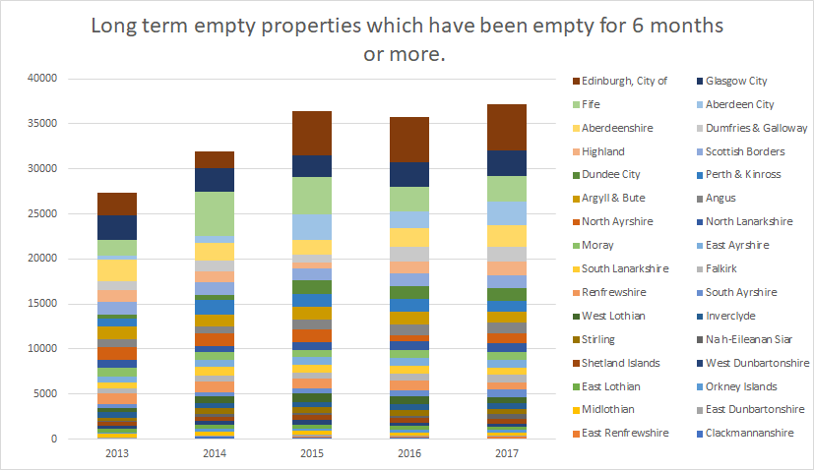
Where will this stock come from?
http://www.gov.scot/Topics/Statistics/Browse/Housing-Regeneration/HSfS/LTemptysecondhomes/EmptySecondhometables

Slide 30
Solution
Scrape private rental sector for potential economical properties, low price per room, to help meet demands.
Council acquires lease, pays deposit, regular rent payments. Collective bargaining guarantor on behalf of AppRENTices who get good shared rent deal.
Council needs to set aside funds to cover cleaning, tenancy disputes, deposit cover, non utilisation, etc.

Slide 31
Solution
AppRent - website/app which gathers users profile and housing requirements, and provides a list of compatible accommodation. They can then apply through council services.
Aimed at AppRENTices but could be expanded for other vulnerable people.

Slide 32
AppRENT - Jobseeker Profile - General
Trying to capture vulnerable people
Age - Gender - Went to school in the UK? - First Language / English Fluency? - Where is home? - Left home before? - minimum wage job seeker? - Apprentice? - Worked before? - Graduate? - Numerous Abuses (domestic, sexual, substance) - Mental health - Physical health

Slide 33
Case Study
Eg. 18 yr female jobseeker seeks shared female only, no alcohol, no known drug dependencies, near nursing apprentice hospital in Aberdeen.

Slide 34
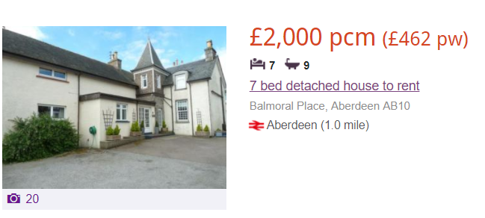
Examples
Central Aberdeen
7 bed 9 bath
£285 per room pcm

Slide 35
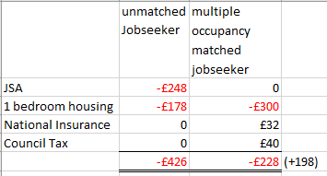
Case Study 18 yr JobSeeker
Assumes £1:£1 council gets kickback for matching jobseeker

Slide 36
Case Study 18 yr JobSeeker
Simple model suggests +£198 government saving when matching jobseeker with multiple occupancy.
Scales even more if including jobseeker promotions, wage rises, VAT and duties collection, wellbeing, development, etc.

Slide 37
Solution
Signposting at Job Centres to point candidates to the AppRENT service.
Collaborate with industry seeking to recruit apprenticeships
Weekly social care checkups if required

Slide 38
Business Plan
Our proposal would be a 60:40 partnership between us.
60%: Ian, backend developer, MSc Heriot Watt Software Systems, BSc Mechatronics Engineer,
40%: Khaled, frontend and backend developer.
Monthly costs: £5k wages, £500 operating expenses (server, desk space)
1 year to implement working product, collaborating with council serives, job centres, housing charities. Cost of £66k.

Slide 39
Solution
Council Funded
Charity Funded
Building/construction companies

